Slide 1
GANK DRONE Z87H3-A3X

Slide 2
What is L337
“L337” The term L337 (LEET) is derived from ELITE. The leet alphabet is a specialized form of symbolic writing. The term leet is used as an adjective to describe formidable prowess or accomplishment, especially in the fields of online gaming. To have what one calls “leet” skills means that the skills exceed those of others around them

Slide 3
L337 was created to dedicate efforts in developing products focused on gamers
We believe in the spirit of competition and the fruits of our labor will be passed to our customers as we strive to tailor our products from them

Slide 4
L337 Vision & Mission
L337 Vision L337 Promise To You: To expect nothing but the best from our products The highest quality products with the top-notch technology Tailored design and technology for game-winning competitive edge Style that embodies the gamer spirit in everything that L337 does L337 Mission L337 is committed to creating gaming products that are designed to enhance your gaming experience to the highest potential Through a perpetual feedback loop with the gamer community, L337 will turn gamers wants, needs, and dreams into reality

Slide 5
L337 Logo
Perfectly symmetrical and balanced logo design which is composed of“L337” The color of gold is symbolic of high class and ECS premium assets

Slide 6
L337 Logo
Battle Ready
The two abstract fists represent
competition, attack, and victory
Gamers are all about competition
Gamers are always Battle Ready

Slide 7
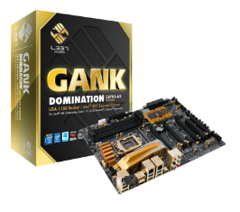
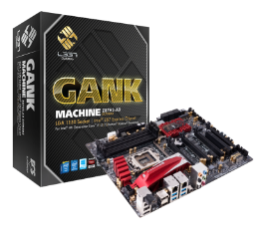
The L337 CLASSES Each L337 Series Has Three Different Class Tiers with Different Features
DOMINATION Luxury Edition Design for the professional gamer. Loaded the best features, the most expandability and the highest quality components. Perfect for overclocking.
MACHINE Extreme Edition Designed for the hardcore gamer. Loaded with new features, expandability and quality components for great performance.
DRONE Deluxe Edition Designed for the extreme gamer. Plenty of features and quality. Great for those looking to become the next professional gamer.

Slide 8
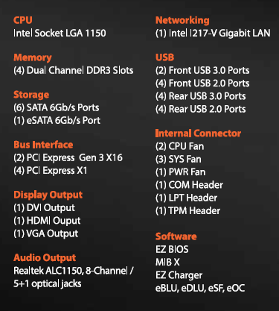
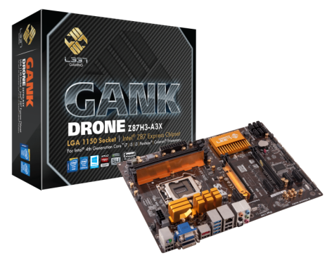
GANK DRONE Z87H3-A3X Gaming Motherboard

Slide 9
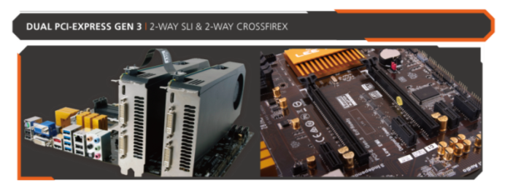
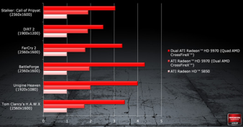
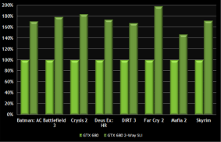
EXTREME GAMING DUAL PCI-EXPRESS X16 GEN. 3 SUPPORT 2-WAY SLI & 2-WAY CROSSFIREX
PERFORMANCE UP TO 1.9X

Slide 10
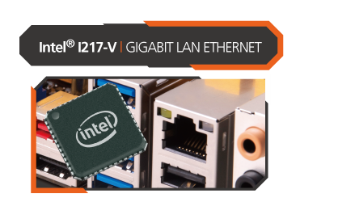
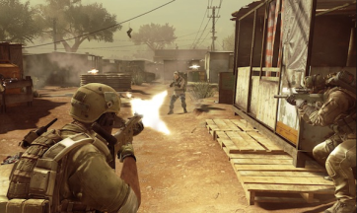
EXTREME NETWORKING INTEL I217-V GIGABIT LAN ETHERNET
EXTREME GAMING SPEED
INTEL I217-V GIGABIT LAN ETHERNET SUPPORTS
Intel® Smart Connect Technology
Intel® Smart Response Technology
Intel® Rapid Start Technology

Slide 11
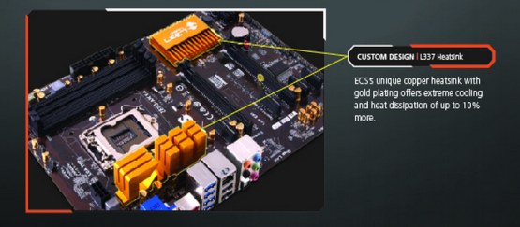
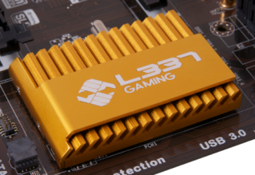
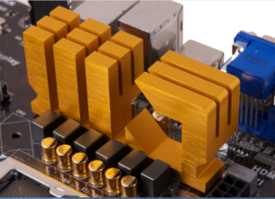
Ultimate Cooling Solutions L337 EXCLUSIVE HEATSINK DESIGN IS THE CHOICE FOR GREAT COOLING

Slide 12
EXTREME POWER MODULE L337 EXCLUSIVE CONPONENT DESIGN FOR ULTIMATE COOLING AND EFFICIENCY

Slide 13
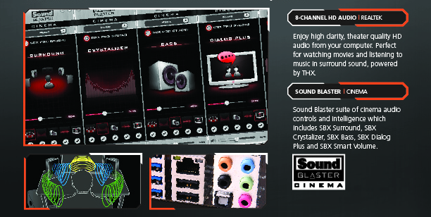
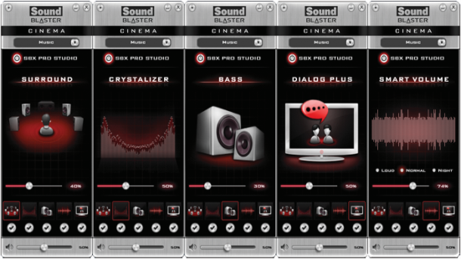
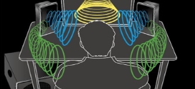
EXTREME AUDIO REALTEK ALC 1150 8-CHANNEL HD AUDIO FOR CRYSTAL CLEAR SOUND QUALITY

Slide 14
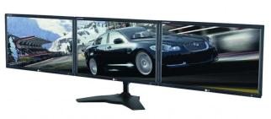
EXTREME GRAPHICS TRIPLE OUTPUT WITH 3-WAY VIDEO ACROSS 3 SCREENS SIMULTANEOUSLY

Slide 15
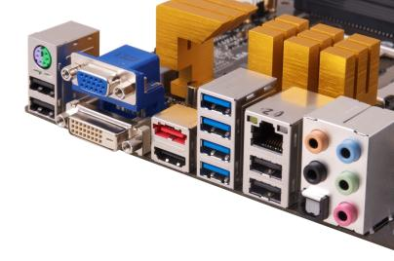
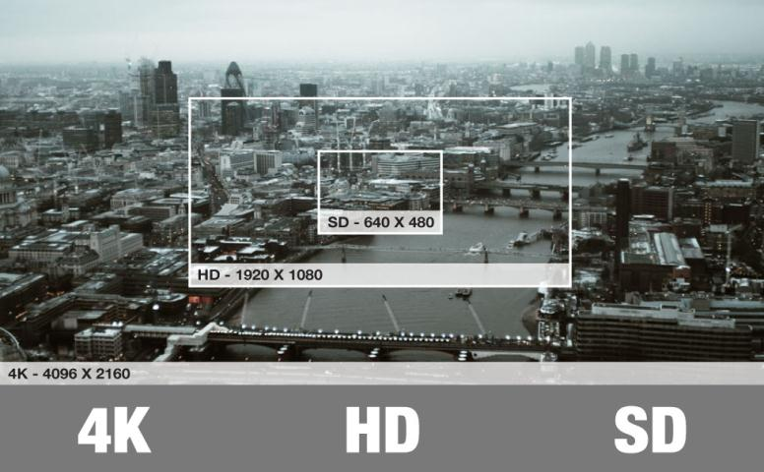
EXTREME GRAPHICS HDMI SUPPORTS 4K RESOLUTION (4096x2160 or 3840x2160)

Slide 16
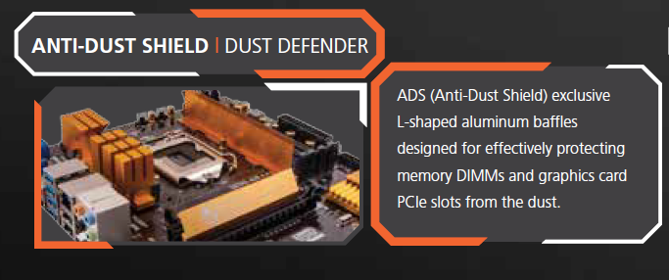
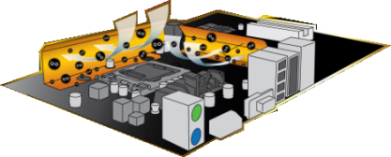
EXTREME PROTECTION ADS (ANTI-DUST SHIELD) PROVIDES THE BEST PROTECTION FOR MEMORY DIMM AND GRAPHICS CARD PCIE SLOT

Slide 17
Dual PCI Express Gen3 x 16
NVIDIA® 2-Way SLI & AMD® 2-Way CrossFireX™
Intel I217-V GIGA LAN
4 Dual Channel DDR3 up to 3000+
Realtek ALC1150 8-CH HD Audio
SoundBlaster Cinema
TDP up to 125W support
6 Phase Power Design
3 Independent Displays (HDMI+DVI+D-Sub)
GANK DRONE Z87H3-A3X

Slide 18
ADS (Anti-Dust Shield)
Durathon Technology
Golden Solid Capacitor
EZ Charger
ESD Protection
Supports DirectX® 11.1
Supports Intel® Smart Response, Smart Connect & Rapid Start Technology
Supports GUI UEFI
MIB X OC Utility
ECS Intelligent EZ Utility: eBLU, eDLU, eOC, eSF
GANK DRONE Z87H3-A3X

Slide 19
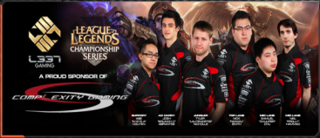
Pro Gaming Community
Official Sponsor of
Complexity Gaming L337 Gaming is proud to announce we are now official sponsors of Complexity Gaming and their entire stable of amazingly talented professional gamers. Complexity Gaming continues to be a leading organization in every major competitive gaming titles

Slide 20
Pro Gaming Community
Gamer Manifesto Today's gamers are tomorrow's leaders so we strive to create products that give you that competitive gaming edge so that your successes in gaming will lead to success in life. With high quality components and top notch performance L337 Gaming will help you get Battle Ready for the gaming world as well as the real world. L337 in life... L337 for life.

Slide 21
www.L337gaming.com

Slide 22
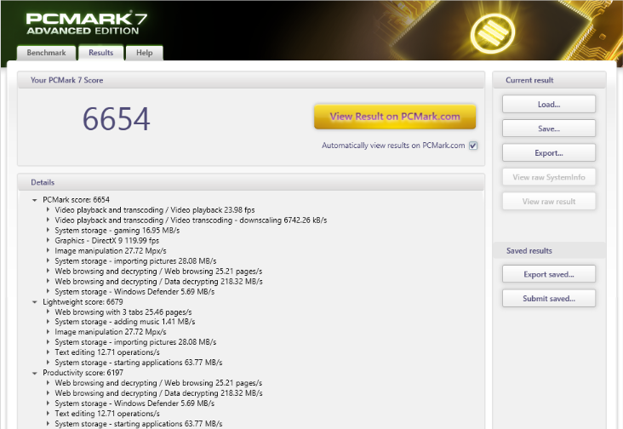
Performance Testing

Slide 23
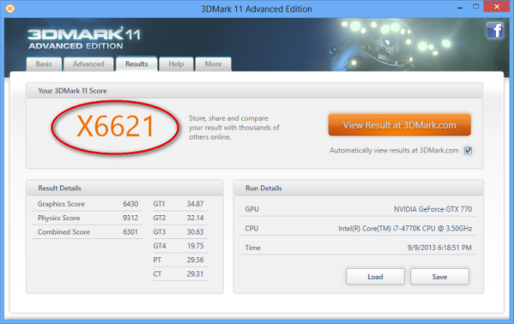
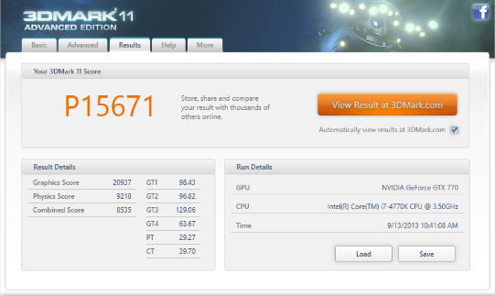
Performance Testing

Slide 24
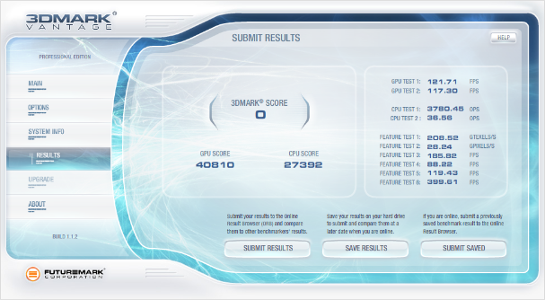
Performance Testing

Slide 25
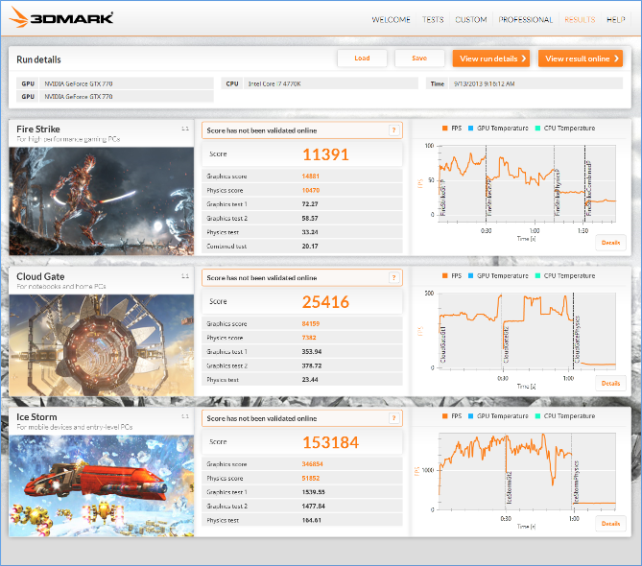
Performance Testing

Slide 26
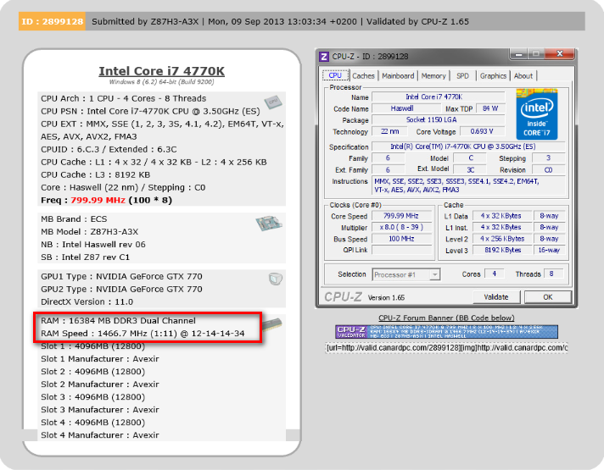
Performance Testing

